Slide 1
Leap Forward with Industry 4.0

Slide 2
CENSOF
First board listed company in KLSE since 2011 Group of 8 companies that is on various industries
LARGEST
Technology Training Provider in Malaysia
SAP, Microsoft Learning Partner, Oracle University, Android AP
ISO 9001 CERTIFIED
Quality & Service
1,000 COMPANIES, 10,000 STUDENTS TRAINED
Delivering training + certification programs on technology since 2001
HIGHEST
Passing Rate for TECHNOLOGY Certification programs

Slide 3
AWARDS
PSMB Training Provide of the Year 2015 – Minister Award
SME TOP 100 Companies 2015
SAP Training Provider of the Year – 2011 and 2013
MIEC Education Industry Top Award - 2015
GRANTS
Technology certification programs grant available for fresh graduates, unemployed, working adults and retrenched workers from various government agencies
ACADEMIA PARTNERSHIP
Creation and design of hybrid programs that combines academic and professional certification for the industry.
Collaboration with local and international universities
START-TO-END
Select – Recruit – Training – Certification – Placement

Slide 4
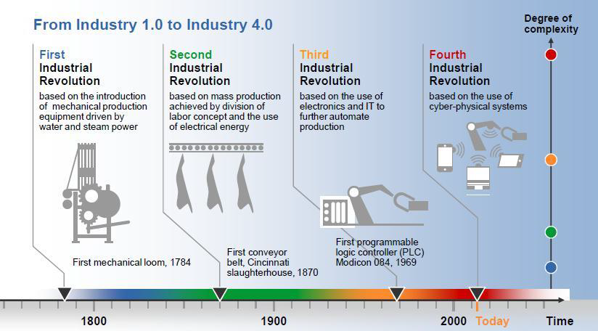
The Industry 4.0 Transformation

Slide 5
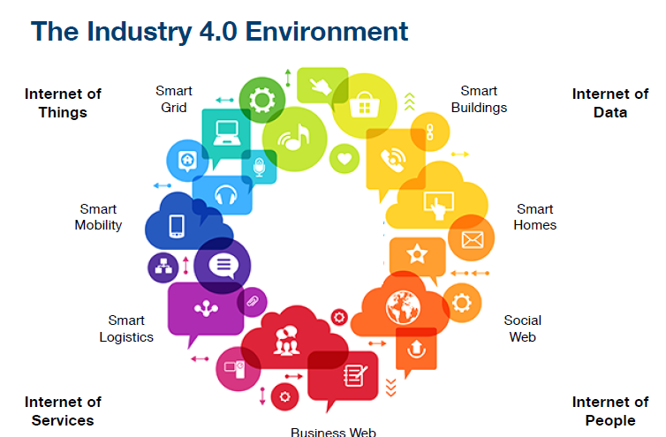
The Industry 4.0 Environment

Slide 6
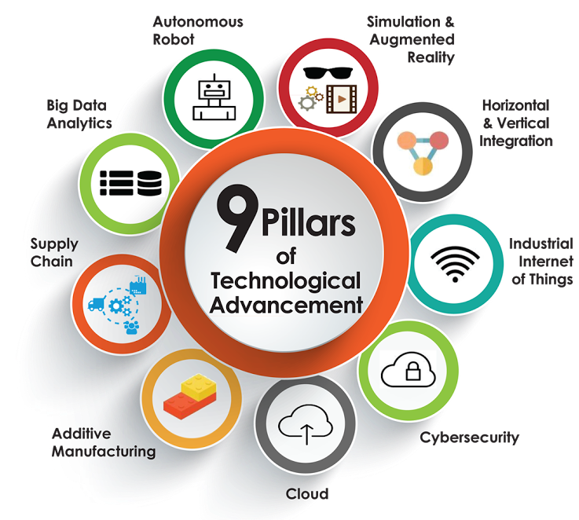
9 Technology Pillars – Industry 4.0

Slide 7
Industry 4.0: Why we need it?
Cost
Complexity
Customer
Competition
Eliminate waste & losses
Eliminate hidden cost
Cost reduction
Sub-Nano technology
Cyber Physical System
Exponential technologies
Personalize
Fast, Cheap, Quality
Total Customer Satisfaction
Digitalization
Increase competitiveness
Globalization

Slide 8
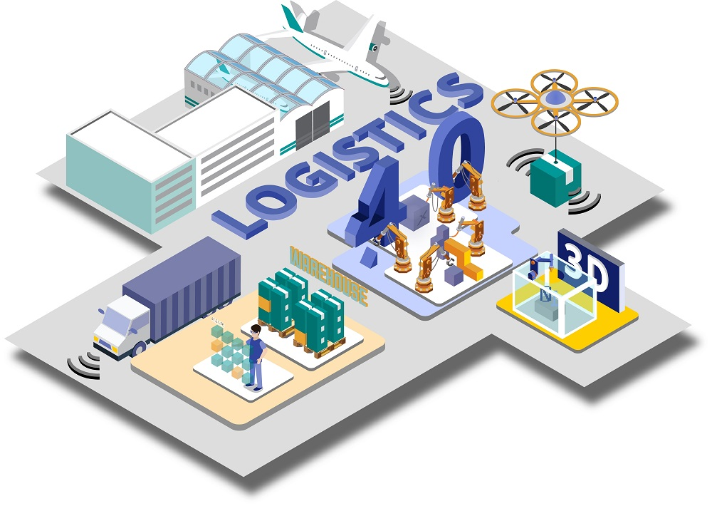
Industry 4.0: Framework

Slide 9
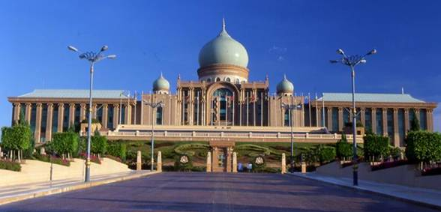
Industry 4.0: Key Challenges
Skill
Knowledge
Expertise
Attitude
New emerging technologies (Augmented reality, Cyber Security, IoT, Big Data Analytics, etc.)
Multi discipline role and responsibilities to support the new revolution.
Lack on local expertise to create and provide new training program.
Develop ‘I LOVE TECHNOLOGY’ attitude and mind-set.
Lack on local content for system hardware and software.
GOVERNMENT
EDUCATION & TRAINING
Policy on Industry 4.0 related research and development, security of integrated system, legal framework conditions, work, training and further education.
New Industry 4.0 technology and skill transfer from overseas as part of pioneer status application. Localize hardware assembly.
High level nationwide Industry 4.0 framework and review panel/board.
Digitalization in manufacturing technologies will require new incentive.
POLICIES
INDUSTRY
Merging the old and new system, techniques, machinery, protocols with complex protocols will be complicated.
Traditional IT infrastructure merging with new IIoT system integration will require massive reorg and reskill of the workforce.
FRAGMENTED LAYOUT

Slide 10
Industry 4.0: Key Challenges
Data ransom at the rise of the focus by hackers and system attackers.
Manufacturing sector are more vulnerable to attack with interconnectivity through cyber physical system.
Require more white hacker to develop full proof security system as attacker continue to look for loop hole.
DATA SECURITY & PRIVACY
INDUSTRY
More data scientist needed means more statistician with operational background.
More complex bid data analytics from industrial data source. Not typical consumer based data anymore and transforming into well structured data format.
BIG DATA
Industry 4.0 is about transforming the organization into new culture and promote technology as the way to move forward. Top management must endorse on it first before the rest follow.
Need more systematic master framework to ease the deployment plan.
CORPORATE
(CULTURE, FINANCIAL, STRUCTURE)

Slide 11
Industry 4.0: Key Driver [ Skill, Policy, Culture]
HIGHER LEARNING INSTITUTION
TECHNICAL DEVELOPMENT INSTITUTION
GOVERNMENT
INDUSTRY 4.0
INDUSTRIES
(NEW CORPORATE CULTURE)
Skill
Reskill / Upskill / New skill
Syllabus & Curriculum revision
Policy
Incentive, Data security
Foreign labour, Digitalisation, ICT infrastructure
Culture
New paradigm shift in corporate culture
Change process

Slide 12
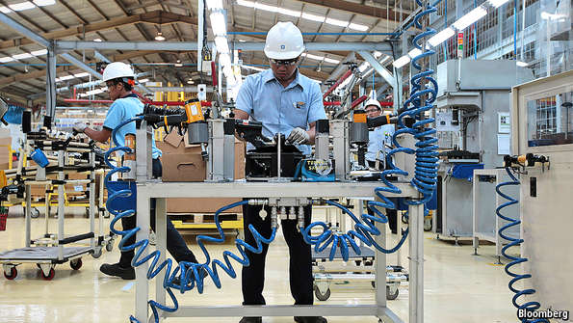
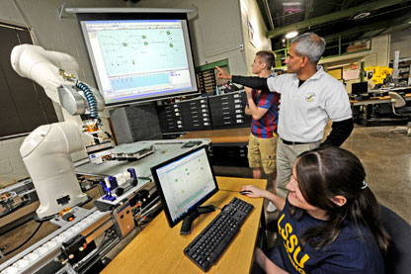
Industry 4.0: Workforce Transformation (Malaysia)
INDUSTRIES
GRADUATES
TERTIARY
(TVET)

Slide 13
Industry 4.0: Workforce Transformation (Malaysia)
CURRENT
INDUSTRY 4.0
High Skilled Technical (Engineer)
High Skilled Innovator (Engineer)
Mid Skilled (Technician)
Local
Local (Existing)
Mid Skilled (Specialist)
Foreign
Local (Upgrade)
Low Skilled
(Operator)
Local
Robotics
Low Skilled
(Operator)
Foreign
Automation
Industry 4.0 will eliminate our dependency on Foreign labour workforce
Industry 4.0 will provide platform for job upgrade on existing local workforce

Slide 14
Engagement and Assessment – 2017/2018
Government Agencies :
Meeting with our Industry 4.0 Partner with the government agencies (MOHR,HRDF, MITI, EPU, MDeC, Talent Corp, YPPB)
Industry 4.0 Sites :
12 sites; 5 state skill centres, 2 public universities; 5 polytechnics. To be increased to 18 by next quarter.
Industry Engagement :
More then 150 companies across 5 states; Penang, Perak, Johor, Sabah and Sarawak. MNC, SMI and SME
Individual :
320 from workforce, university and polytechnic students – IR 4.0 projects, certification or trainings.
Public Engagements :
More then 1500, workforce (Public & Private), Universities and colleges.

Slide 15
Engagement and Assessment – 2017/2018
S/S: 150 pax (Participated during the Industry 4.0 Training)

Slide 16
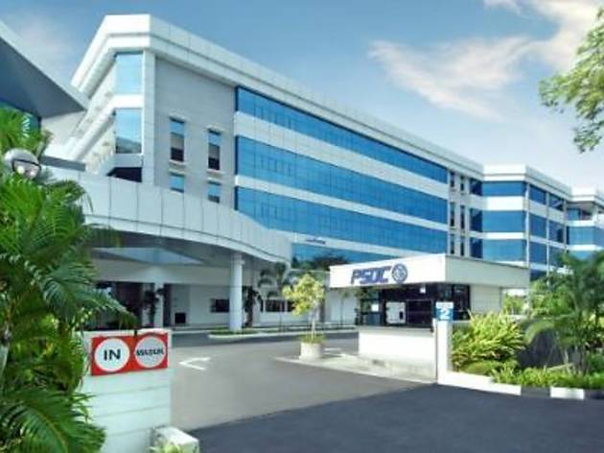
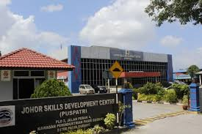
Industry 4.0: Center of Excellence in Technology (CoET)
STATE SKILL CENTERS
Penang Skill Development Centre (PSDC)
Johor Skill Development Centre (PUSPATRI)
Perak Human Capital Development Centre (PHCDC)
Sabah Skills and Technology Centre (SSTC)
Pusat Pembangunan Kemahiran Sarawak (PPKS)
UNIVERSITIES
University Putra Malaysia (UPM)
University Kebangsaan Malaysia (UKM)
POLYTECHNICS
Politeknik Ibrahim Sultan (PIS)
Politeknik Seberang Perai (PSP)
Politeknik Kota Kinabalu (PKK)
Politeknik Kuching Sarawak (PKS)
Politeknik Shah Alam (PSA)

Slide 17
THANK YOU
For more information on our services and products, please visit: www.eknowledge.com.my
Subscribe and Follow our FACEBOOK page, click to:
www.facebook.com/knowledgecom

